Slide 1




Group 4 : Storage Devices
Syahidatul najwa BINTI ZAMRI
(SX241889ECJHF01)
SPAANDIAN A/L SINNASAMY
(SX240264ECRHS01)
MUHAMMAD HARIZ ISKANDAR BIN OTHMAN (SX231693ECJHF01)
LEAVINISH A/L BALASUBRAMANIAM SX240278ECRHS0111)

Slide 2
i. Whats is storage in computing? - the process of saving and retaining digital data. -It allows information, files, and programs to be stored for retrieval at a later time. -Without storage, computers would not have the capacity to keep data persistently beyond their immediate operations.

Slide 3
ii.Types of storage: primary vs secondary
ii.Types of storage: primary vs secondary
Primary Storage: This is the computer's memory (RAM) used for short-term tasks. It is fast but volatile—data is lost when the device powers off.
Secondary Storage: This is long-term storage where data remains even when the device is turned off. It includes hard drives, solid-state drives, and external devices.

Slide 4
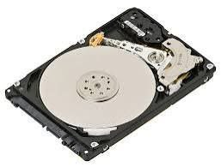
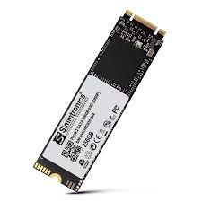
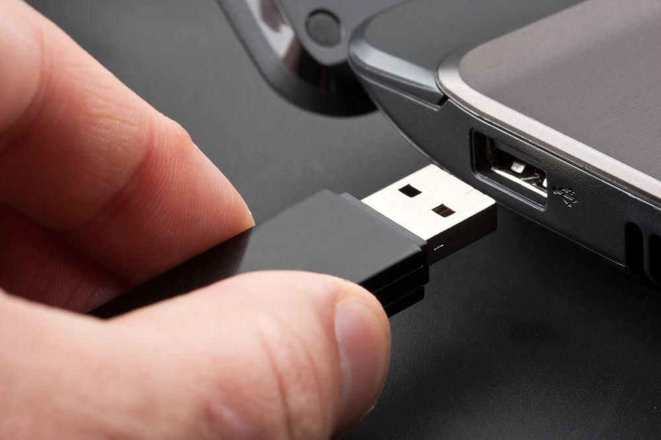
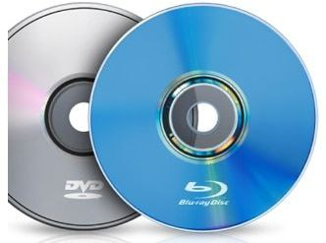
iii. Examples of storage devices: HDD, SSD, USB flash drives, CDs/DVDs
-HDD (Hard Disk Drive): A mechanical device with spinning disks for storing large amounts of data.
-SSD (Solid-State Drive): A faster, durable option that uses flash memory.
-USB Flash Drives: Portable and convenient for transferring smaller amounts of data.
-CDs/DVDs: Optical discs for storing multimedia or software files (less common these days).

Slide 5
iv. Differences in speed, capacity, and cost
 | Device | Speed | Capacity | Cost
 | HDD | Moderate | High | Affordable
 | SSD | Very Fast | Moderate to High | Expensive per GB
 | USB Flash Drive | Moderate | Low to Moderate | Affordable
 | CD/DVD | Slow | Low | Very cheap (but outdated)

Slide 6






v. Current trends -cloud storage -google drive -icloud -aws(amazon web services) -Microsoft azure -oracle

Slide 7
conclusion
Storage is essential in computing for saving and retrieving data and programs . It includes primary storage (e.g., RAM) for temporary data and secondary storage (e.g., SSD, HDD) for long-term use. Different storage types vary in speed, capacity, and cost, each suitable for different purposes. Current trends like cloud storage make data accessible from anywhere and support remote work.New technologies (like NVMe SSDs) offer faster performance and better reliabilit

Slide 8

quiz
Quiz Question 1:Quiz Question 1: Which of the following is an example of primary storage? A. Hard Disk Drive (HDD) B. USB Flash Drive C. Random Access Memory (RAM) D. DVD A. Hard Disk Drive (HDD) B. Quiz Question 2: Which type of storage is typically faster but more expensive per GB? A. HDD B. SSD C. CD/DVD D. USB Flash Drive Flash Drive C. Random Access Memory (RAM) D. DVD

